Slide 1

Credit Card Fraud Detection

Slide 2
Table of Contents
Introduction
01
Detection Approaches
02
03
Conclusion
04
Common Machine Learning Algorithms
Team Members:
1)Nakka Saicharan
2)Alladi Lalith Kumar
3)Sunkari Sai krish Goud
4)Bussa Sathwik

Slide 3
INTRODUCTION:
Credit card fraud involves unauthorized use of someone's credit card or card information for purchases.
The increase in electronic transactions and e-commerce has accelerated the occurrence of credit card fraud.
Types of Credit Card Fraud:
Card-present fraud (physical cards)
Card-not-present fraud (online/phone)
Lost/stolen cards, counterfeit cards, phishing

Slide 4
Challenges in Fraud Detection:
Massive volume of daily transactions
Extremely imbalanced datasets (fraud cases are rare: e.g., 492 out of 284,807 transactions in a common dataset).
Need for real-time detection
Minimizing false positives to avoid inconvenience for legitimate users.
Detection Approaches:
Rule-based systems: Manual if-then rules (e.g., purchase amount/exceeding limits)
Machine Learning (ML) methods: Automatically finds patterns in transactions
  Supervised algorithms use labeled data (fraud/not fraud)
  Unsupervised methods detect anomalies without labeled data

Slide 5
Common Machine Learning Algorithms:
k-Nearest Neighbours (KNN): Compares new transactions with nearest past transactions
Logistic Regression: Predicts probability of fraud based on transaction features
Decision Trees & Random Forest: Tree-based classification
Naive Bayes: Uses probability theory for classification
Deep Learning (DNN, CNN): Handles large, complex datasets; higher accuracy but more computation-intensive
Boosting Algorithms (e.g., XGBoost, AdaBoost): Combine weak learners to improve prediction performance.

Slide 6
Model Evaluation Metrics:
Accuracy: Total correct predictions / all predictions
Precision, Recall, F1-score: Evaluate performance on rare fraud cases
Area Under Curve (AUC): Discriminative power of the model
Data and Preprocessing:
Datasets contain features like Amount, Time, Transaction type.
Data preprocessing: Feature engineering, handling missing values, balancing data (oversampling/under sampling/SMOTE)

Slide 7
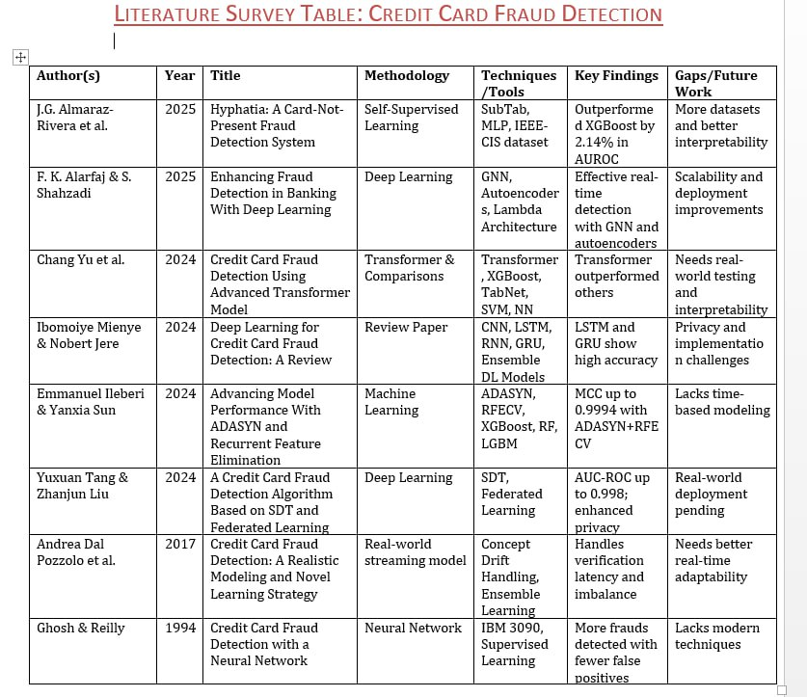

Slide 8
Architectures and Optimization Parameters of Existing Systems
Existing fraud detection systems commonly use machine learning models like Random Forest, XGBoost, and sometimes Neural Networks. Their architecture includes:
Input Layer: Takes preprocessed transaction data including PCA features (V1–V28), transaction time, and amount.
Model Layers: Ensemble learning methods like Random Forest combine multiple decision trees, while XGBoost applies gradient boosting to improve predictions.
Output Layer: Provides classification of transactions as fraudulent or legitimate along with a confidence score.
Optimization Parameters used:
Number of trees in Random Forest (e.g., 100 to 500)
Maximum depth of trees (e.g., 5 to 15)
Learning rate for XGBoost (e.g., 0.01 to 0.3)
Number of boosting rounds in XGBoost (e.g., 100 to 1000)
Regularization parameters to reduce overfitting

Slide 9
Proposed Model Architecture and Optimization Parameters
Proposed Architecture:
Data Input & Preprocessing: Normalize data, apply PCA, and balance classes using SMOTE.
Feature Selection: Use correlation analysis to choose top features.
Model: An ensemble combining Random Forest and XGBoost for robust detection.
Output: Class (Fraud/Legitimate), fraud probability, and risk score.
Adaptation Layer: Periodic retraining based on new data for evolving pattern recognition.
Optimization Parameters:
Random Forest:
  Number of Trees: 200
  Max Depth: 10
XGBoost:
  Learning Rate: 0.1
  Boosting Rounds: 500
  Regularization (lambda): 1

Slide 10


Slide 11
CONCLUSION:
Credit card fraud detection is essential to safeguard digital transactions and financial data. Machine learning and advanced analytics significantly enhance the identification and prevention of fraudulent activities. Ongoing innovation and adaptive strategies are crucial for staying ahead of evolving fraud tactics.

